Slide 1


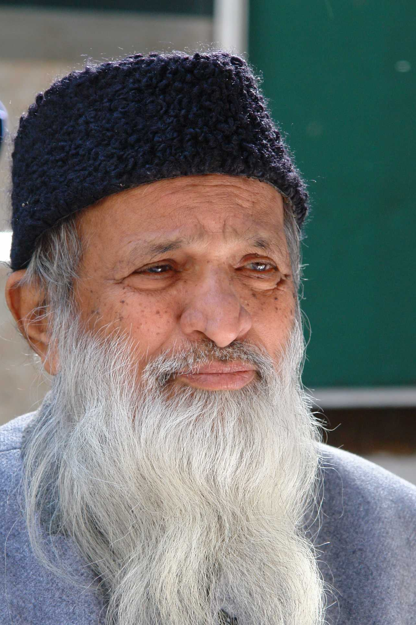
Abdul Sattar Edhi
Abdullah (02-131222-099)

Slide 2
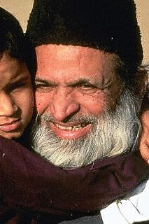
Who was Abdul Sattar Edhi?
Abdul Sattar Edhi was a renowned humanitarians in Pakistan's history.
He is known amongst Pakistanis as the "Angel of Mercy"
He was born on February 28, 1928, in Gujarat, British India, and passed away on July 8, 2016, in Karachi, Pakistan.
He founded the Edhi Foundation, which runs the world's largest ambulance network, along with rehabilitation centers, and orphanages across Pakistan.
Abdul Sattar Edhi was a person who had a deep sense of empathy and kindness for the suffering of others. He never discriminated against anyone based on their religion, ethnicity, or nationality.

Slide 3

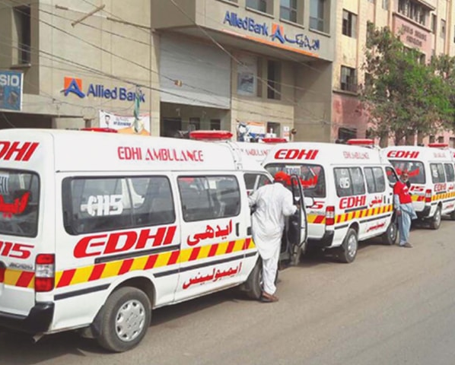
Career Highlights
Started his career as a street hawker in Karachi, Pakistan, then became a commission agent selling cloth in the wholesale market.
After a few years, he decided to establish a dispensary with the help of his community and began providing emergency services to the people in need.
His charitable activities expanded in 1957 when an Asian flu epidemic swept through Pakistan and the rest of the world.
He participated in many rescue and relief operations such as the 1970 cyclone and the 1974 famine in Ethiopia, the 1985 earthquake in Mexico, the 2005 earthquake and the 2010 floods in Pakistan.
The Edhi Foundation expanded, backed by donations from Pakistani citizens which included establishing a network of 1,800 ambulances. By the time of his death, Edhi was registered as guardian of nearly 20,000 adopted children.

Slide 4
Obstacles
He faced poverty and hardship as a young migrant in Karachi after the partition of India. He also faced hostility and discrimination from some members of his own community who did not approve of his social work.
He faced challenges in maintaining and expanding his foundation's services due to the lack of government support, corruption, bureaucracy, and security issues. He often had to sell his personal belongings or borrow money to keep his foundation running.
He faced opposition and threats from some religious extremists and political groups who accused him of being a heretic, a spy, or a traitor. He was also attacked several times by armed men who tried to rob or kidnap him or his staff. He survived a bomb blast near his office in 2013 that killed three people.

Slide 5

What inspired him?
His mother was his first inspiration. She taught him to be kind and generous. She gave him some money every day to help someone in need. She suffered from paralysis for eight years before she died, which made him more compassionate towards the sick and disabled.
His wife Bilquis Edhi supported him in his mission and shared his vision. She helped him run the maternity homes, adoption centers, women's shelters, and nursing homes. She helped him in many rescue missions and relief operations. She was awarded the Mother Teresa Award for Social Justice in 2015 for her humanitarian work.
He followed the principle of "service to humanity is service to God“ He believed that all human beings are equal and deserve respect and dignity regardless of their religion or caste.

Slide 6
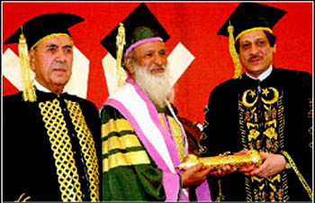
Achievements
He received many awards and honors for his humanitarian services. Some of them are:
The Ramon Magsaysay Award for Public Service in 1986
The Nishan-e-Imtiaz in 1989
The Lenin Peace Prize in 1992
Wolf of Bhogio Peace Award (2005)
The Gandhi Peace Award in 2007
UNESCO-Madanjeet Singh Prize
He was also nominated several times for the Nobel Peace Prize.

Slide 7
Conclusion
Abdul Sattar Edhi lived a simple life and believed in selflessness. He dedicated his entire life to the service of humanity. He is a true hero and a role model for millions of people around the world.

Slide 8
Sources:
https://en.wikipedia.org/wiki/Abdul_Sattar_Edhi.
https://www.aljazeera.com/news/2017/2/28/14-things-to-know-about-abdul-sattar-edhi.
https://edhi.org/founder-profile/.
https://pantheon.world/profile/person/Abdul_Sattar_Edhi/.

